Slide 1
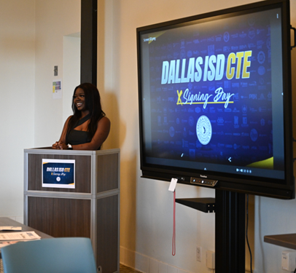
Welcome!
Please enter into the chat your name and organization
Please enter questions in the Q&A box
This webinar will begin at 11:30 a.m.
This will be recorded and content will be shared with all registrants after

Slide 2
How to Host a Career Signing Day
Thursday, April 27, 2023
11:30am-12:30pm CDT
Moderator: Lori Knight, Education Outreach Manager
Amy Landrum, Campaigns & Creative Content Director
Texas Workforce Commission
Notes:
Lori
Good Morning and thanks so much for joining us for "How to Host a Career Signing Day"
The call is hosted by Texas Workforce Commission
I’m your moderator - Lori Knight, Education Outreach Manager
I’ll be joined by my colleague Amy Landrum, Campaigns and Creative Content Director
- Housekeeping -
Lori – for those who may not know me, I do xyz for TWC
Amy – for those who may not know me, I do abc for TWC

Slide 3
Guest Speakers
Notes:
Lori
We are also very happy to have a few special guests with us today
You can't have a signing day without a supportive school principal to endorse it
Or a CTE Coordinator to coordinate it
Thank you to Ms. Claudette Garcia Principal of Premont Collegiate High School
Latasha Wilson Career and Technical Education Coordinator with Pflugerville High School
Shannon Green, Industry Partner Coordinator with Dallas ISD CTE
Paige Crain, Career and Education Outreach Specialist for Workforce Solutions Capital Area
And Karen Stubblefield, Operations Manager for Workforce Solutions Deep East Texas
Who will provide their perspective and best practices

Slide 4
Discussion Topics
Value of a Career Signing Day
Free Resources & Templates
Identify & Celebrate Students
Submit Event Dates & Photos
Coordinate with Community Partners
Make it Movement Fall 2023 Signing Day
Notes:
Lori
Today you'll learn how your school can host your signing day
We'll talk about the value of a career signing
How you can access free resources and templates to plan and promote your big day
Hear best practices on how to identify and celebrate your students
We’ll cover ideas for swag and social media
How and why to coordinate with community partners like your Local Workforce Development Board
Finally, learn how to get involved with the Make it Movement Signing Day this fall

Slide 5
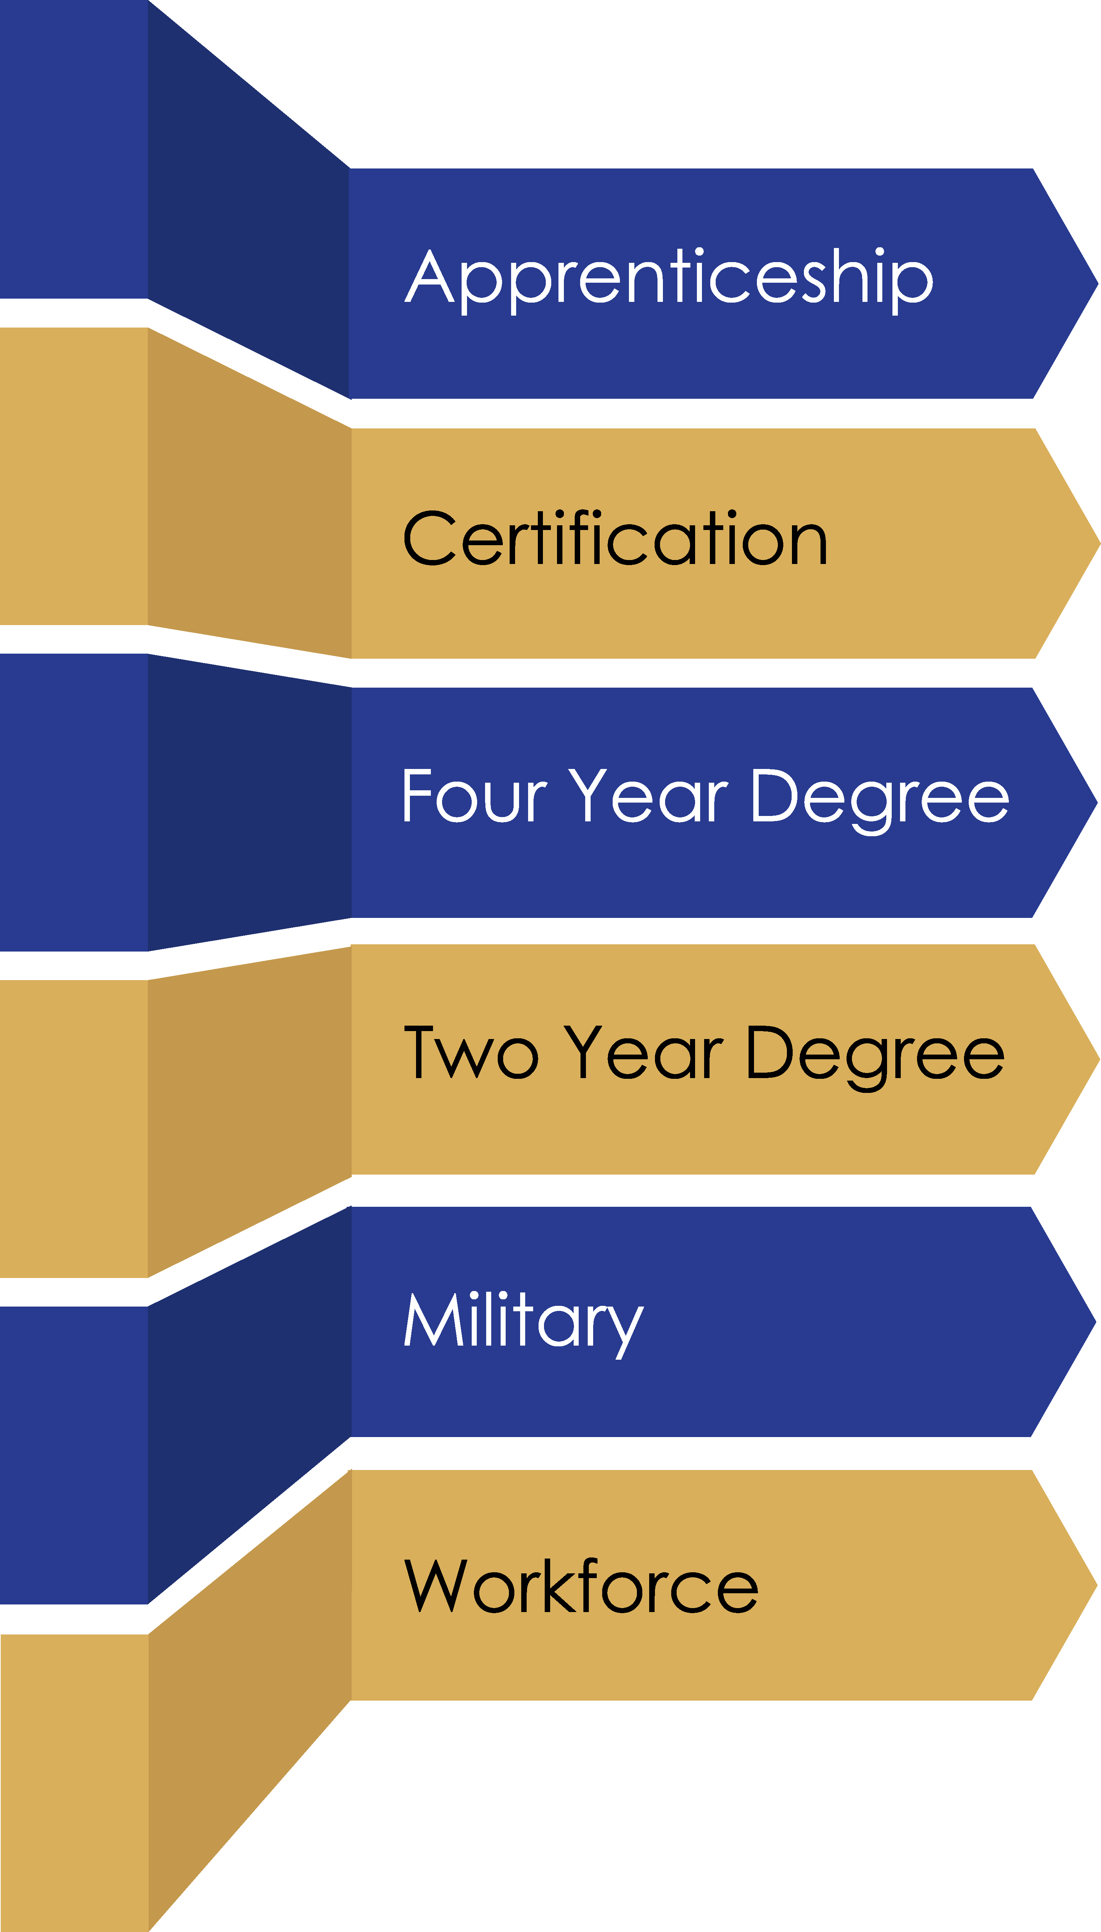
Value
Place value on ALL postsecondary opportunities
Recognize students' big decisions
Celebrate goals and commitments
Support families
Thank employers
Demonstrate community
Notes:
Lori
Texas Career Signing Day provides an opportunity to recognize and celebrate high school students choosing to enter career pathways leading to in-demand careers and occupations directly from high school.
These events are often hosted by Texas high schools typically at the end of the year to honor graduating senioes.
Career Signing events are an opportunity to bring together students and the employers who hire them so they can celebrate with family, friends and educators their commitment to pursuing careers, an apprenticeship, or workforce training programs.
We believe “career” signing days add value to communities by recognizing ALL the opportunities after high school.
It places as much emphasis on a decision to pursue athletics and academics as a decision to pursue occupations. That’s what the long term end-goal is really all about for everyone, right?! We all have to work.
I do want to mention here, that although we tend to speak about choosing academics, athletics, or career pathways as opposing or separate things, combining career signing days to signing day or decision days which are already happening, can be a simple approach to providing recognition to all students at the same time. We will talk more about that in a moment. For now, I'm going to turn things over to Amy Landrum who will share with us some resources you can use to get your own Career Signing events started.

Slide 6
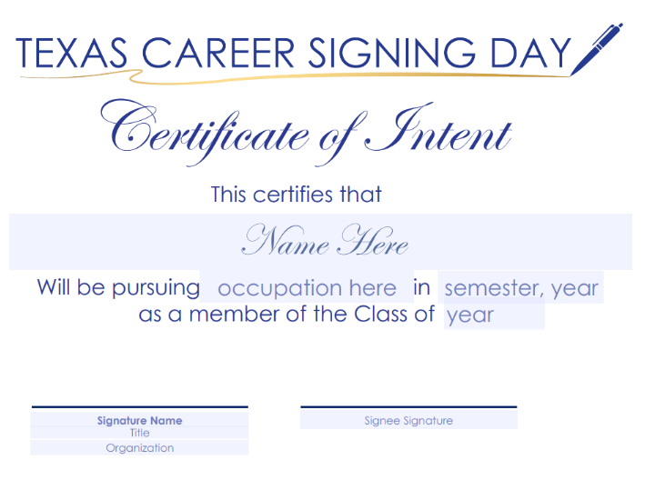
Resources
twc.texas.gov/signingday
Logo
Flyer template
Invitation template
Certificate template
Letter of Intent template
Event planning checklist
Notes:
Amy

Slide 7
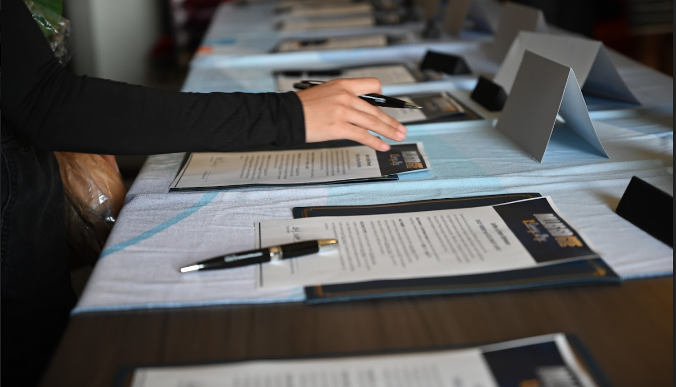
Remember the Pen
Notes:
Amy
The other Star of the Show: the Pen!
Everyone loves a good pen – the students and their families
Opportunity to invest in engraved pens
Opportunity to ask employers or community partners to donate

Slide 8
Best Practices
Notes:
Lori – Open up for a roundtable discussion about Best Practices including around
What did you wish you knew the first time you hosted an event?
Ideas for swag at the events and promoting the events on social media
Then discuss lessons learned
One counselor or POC for the event
Plan early
Ask for documentation from seniors
Publicize the event-Invite parents, the media, and most importantly the rest of the student body
Do not prioritize one signing option over others

Slide 9
Identify Students
Notes:
Lori: Next, identify your students. Let’s discuss your vetting and confirmation process.
- How to identify and vet your students

Slide 10
#Swag
Celebrate Students
Notes:
Lori - Once you determine who you will recognizing, how do you celebrate them? Let’s discuss the event set up, the bling, the swag, the ceremony.

Slide 11
#GetSocial
Notes:
Next, let’s talk about social media. How are you promoting the events, either before or after, on social? What hashtags are you using? Any other tips and tricks that are working well for you?

Slide 12
Coordinate with Partners
Local Workforce Development Boards
Chambers of Commerce
Economic Development Corporations
Education Outreach Specialists
Notes:
Lori, Shannon, Paige – importance of involving partners. A great way to kick off this topic is to play the Dallas ISD CTE promotional video which talks about their event and their partners.

Slide 13
Career and Education Outreach Specialists
Regional Teams who Connect Schools with Employers and Workforce Boards
Contact: CareerInformation@twc.texas.gov
Notes:
Karen or Paige - role of the Education Outreach specialist in connecting schools with employers and Boards
How to contact us

Slide 14
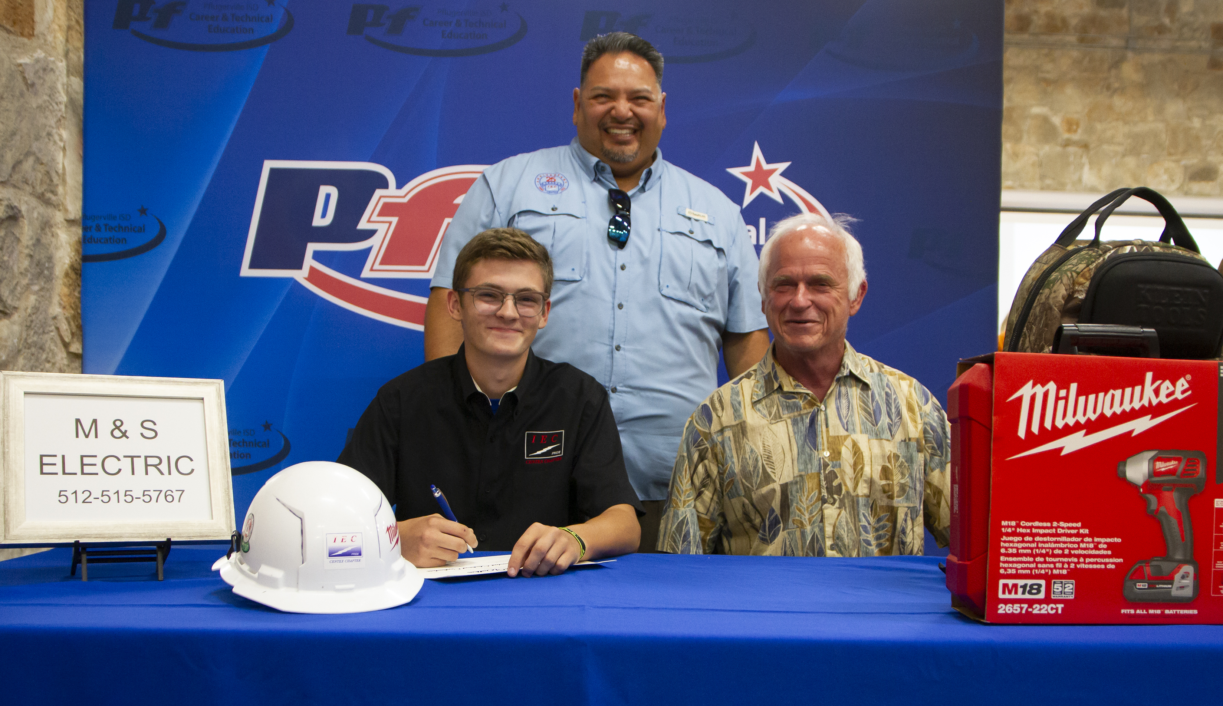
Lessons Learned
Notes:
Lori – Finally lessons learned. Any other learnings you want to share to help those planning these for the first time?

Slide 15
Works with education and workforce systems to create rapid and compelling awareness of the millions of high-skill/high-income careers right now - right here in Texas. Works with school counselors, CTE instructors, and cross-sector leaders to align messaging, resources, and opportunities for students to Make It in Texas.
https://www.makeitmovement.org/
Notes:
Amy – brief overview of Make it Movement. Lori to play video.

Slide 16
Make It Movement
Mission
Method
Event
To create compelling messaging and resources for 15 million Texas students in middle and high school. Rapidly help them gain AWARENESS, KNOWLEDGE and CONFIDENCE about high-skill, high-income careers.
Statewide Signing Day Event October, 6th 2023
AT&T Stadium
Arlington, TX
Use TV, digital online, and social media channels that help students see how their talents and passions can align to career pathways that play to their strengths​​.
Convening statewide School Counselor Alliance, CTE Alliance, and Workforce Solutions partnerships.
Notes:
Amy – brief overview of mission, method and event

Slide 17
Who’s Ready to Sign Up?
Next step: Select a date for May 2024
Only have time for one thing this year? Offer a Certificate.
Submit event details to signingday@twc.texas.gov
Notes:
Lori
We hope we have done a good job of getting you excited about this opportunity. Are you ready to sign on?
I think what you’ve heard today is planning and promoting these events takes a village - and time.
If there’s one thing you can do today – it’s pick a date for a May 2024 event. Start planning now for next year and give yourself time to do it well.
If you want to get started and do something this year and may not have enough time or resources before school ends. You could just use the TWC certificate template to fill in the blanks and offer those to your students.
Optional Recap:
Identify high school seniors and ensure participants are finishing high school with post-secondary certificates or industry-recognized certifications and are eligible to be hired by employers, entering apprenticeships, or any other career pathway programs;
Identify employers to participate in a Texas Career Signing Day and an opportunity to promote programs connecting high school students and employers in the community;
Provide the letter of intent template to the qualifying organization to complete and return for signing day;
Customize and use the templates provided for your big event;
Submit information and questions to TWC as event plans are confirmed to signingday@twc.texas.gov. We’d like to post to our event calendars and help promote through social media.
And please don’t forget to submit photos! We want to share your success!

